Slide 1
Introduction to Clinical Pharmacology Chapter 5 Client and Family Teaching Paula Reeves BSN, RN

Slide 2
Learning Objectives
Describe the steps of client teaching about drug therapy.
Identify important aspects of the client–nurse relationship.
Explain the three components of good health communication.
Identify important aspects of the teaching/learning process.
Describe how to use information about relationship and communication with the nursing process.
Discuss suggestions to make to the client for adapting drug administration in the home.

Slide 3
Client Teaching About Drug Therapy
Client teaching is an essential task in nursing.
Clients must be educated about the drugs they are prescribed in order for the client to:
Understand how to take the drug
Know what signs and symptoms to self-assess for adverse effects
Client teaching involves:
An established relationship
Use of teaching/learning principles
Supplying the client with information
Evaluating the client’s understanding

Slide 4

Step 1: Establishing a Client-Nurse Relationship
Establish trust
Show respect for each individual client
Deliver client-centered care:
The client is the focus of the care
Nurses must understand the changing health care system, culture, and current challenges and barriers to health care to better assist clients in navigating the health care system to access prescribed drugs, which results in better outcomes.
Medicare
Health Care Reconciliation Act
Affordable Care Act
Attitudes
Aging Population
Chronic Illness
Cultural Considerations

Slide 5

Step 2: Use Teaching and Learning Principles #1
Client teaching is an active partnership between the nurse and the client. Both the nurse and client must be actively involved.
Nurses must understand the key principles in teaching clients:
Motivation
Adult learning
Learning styles
Domains of learning

Slide 6

Step 2: Use Teaching and Learning Principles #2
Motivation
A client must be motivated to learn
Motivation depends on client’s perception of need to learn
Nursing actions to enhance motivation
Encourage client participation in planning
Encourage client to co-develop realistic and attainable goals
Create an accepting and positive environment for learning

Slide 7

Step 2: Use Teaching and Learning Principles #3
Adult Learning
Demonstrate technique
Allow time for supervised practice
Help client get ready
Allow client to perform the task

Slide 8
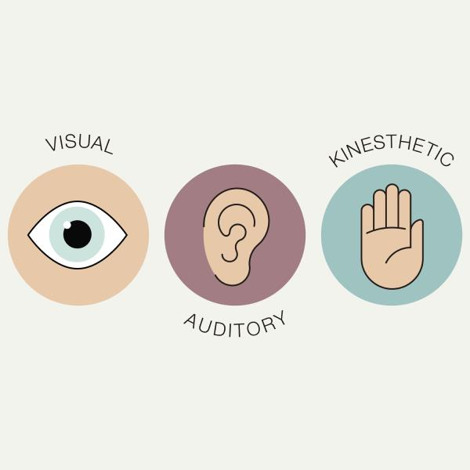
Step 2: Use Teaching and Learning Principles #4
Learning Styles
Visual
Auditory
Kinesthetic
Nursing action: assess the client’s learning style prior to client teaching in order to determine best client-centered teaching methods

Slide 9

Step 2: Use Teaching and Learning Principles #5
Domains of Learning
Cognitive domain- Intellectual
Affective domain- attitudes, beliefs build a therapeutic relationship
Psychomotor domain- skills, return demonstration
Nursing actions:
Consider how the client learns and what they need to learn
Align the teaching method to the appropriate domain of learning. The following are some examples:
Pamphlet (cognitive or affective)
Demonstration (psychomotor)
Discussion (affective)

Slide 10

Pharmacology in Practice Exercise
An 86-year-old client is seen at an urgent care center for sudden heartburn. Which of the following statements made by the assigned nurse demonstrates the use of client-centered care concepts?
“Did you try to fix this at home first?”
“The doctor will be in soon to give you a recommendation.”
“Why didn’t you just go see your own doctor in the morning?”
“You can treat this with over-the-counter medication.”

Slide 11

Step 3: Use of the Nursing Process to Supply the Client With Information #1
Assessment
Gather data
Develop an effective teaching plan
Assess individual’s learning ability
Determine purpose of assessment

Slide 12
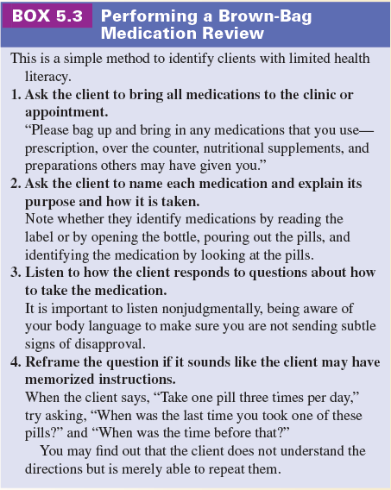
Step 3: Use of the Nursing Process to Supply the Client With Information #2
Good Health Communication
Assessment
Assess the client’s ability to communicate, language preference, and health literacy skills
Utilize cultural competency
Provide the opportunity to “teach back” to assess

Slide 13
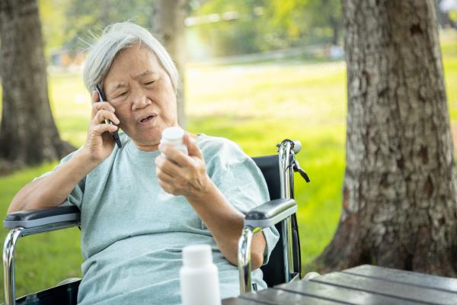
Step 3: Use of the Nursing Process to Supply the Client With Information #3
Nursing Diagnoses
Readiness for Enhanced Health Management
Ineffective Health Management related to lack of knowledge
Deficient Knowledge related to the drug regimen, possible adverse reactions, disease process, or other factors

Slide 14

Step 3: Use of the Nursing Process to Supply the Client With Information #4
Planning—Developing an Individualized Teaching Plan
Use principles of teaching and learning and good health communication when developing the plan
Individualize the teaching plan based on the client’s unique needs
Select relevant information
Utilize concepts of health literacy to select appropriate teaching aids or methods
Repeat teaching sessions as needed

Slide 15
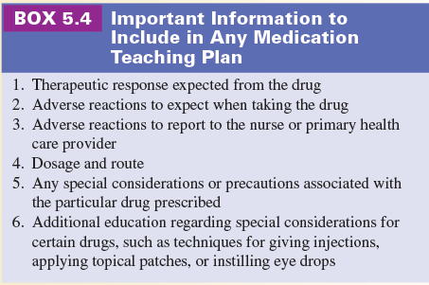
Step 3: Use of the Nursing Process to Supply the Client With Information #5
Implementation of a Teaching Plan
Actual performance: interventions identified in teaching plan
Put the plan into action
Begin teaching
Teach at an appropriate time
Gear teaching to client’s motivation level and level of understanding

Slide 16

Step 4: Evaluation of the Client’s Understanding
Evaluation is the final step in both the nursing process and in the process the teaching process.
Evaluation determines the effectiveness of the client teaching
Client’s confidence
Client’s knowledge
Ask the patient to repeat the info back to you
Avoid Yes or No questions
Client’s skill
Teach-back

Slide 17
Basic Considerations when Developing a Drug Teaching Plan
READ AND REVIEW BOX 5.5

Slide 18
Adapting Drug Administration to the Home Setting
Provide directions to client or family on how to administer the drug and request a teach-back
Some clients benefit from wearing a MedicAlert bracelet
Educate client or family on adverse drug effects and when to report them
Educate client and family
Why the drugs are being taken
How to store the drug
How to administer or take the drug
How to dispose of unused drugs properly

Slide 19

Turn and Talk—Case Study
A 75-year-old woman, who speaks very little English presents at the clinic. She has been referred to you, the nurse, as the clinic-certified diabetes educator for glucometer teaching and diabetes education. She lives with her daughter and her daughter’s family. Her past medical history includes hypertension, hyperlipidemia, and status post cerebrovascular accident with right-sided hemiparesis. The client has just been diagnosed with diabetes.
The nurse desires to establish a good client–nurse relationship. What factors should the nurse address in setting up this relationship?
What is the primary barrier the nurse faces in educating a client with limited English proficiency about her glucometer and her disease state?
What can the nurse do to overcome the barriers and successfully educate the client about her glucometer and her disease state?

